Slide 1



Exploratory Data Analysis Task - Team 2

Slide 2
Table of Contents
1
2
3
Data Description & Statitics
Outliers & Null Values
Feature Relations
Timeline

Slide 3
1
Data Description & Statitics

Slide 4

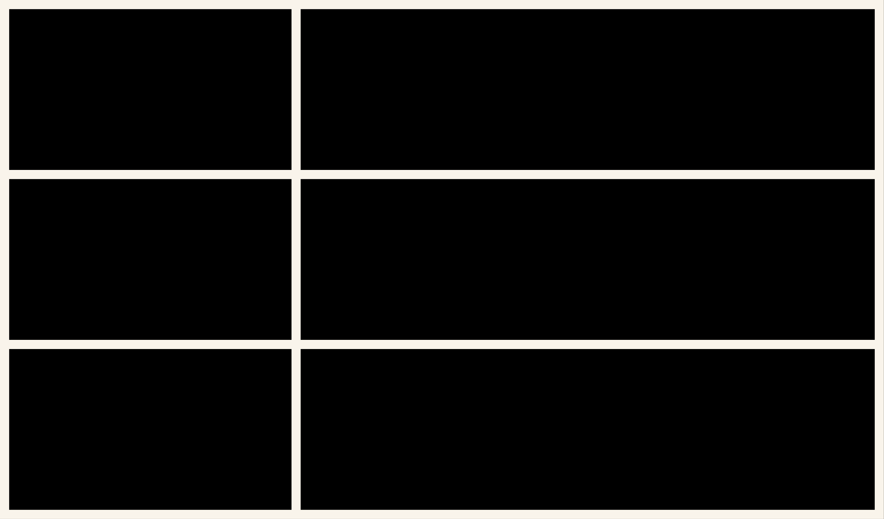
Description
Column Name
Data Type
number of adults
number of children
number of weekend nights
number of week nights
type of meal
car parking space
room type
lead time
market segment type
repeated
P-C
P-not-C
average price
special requests
date of reservation
booking status
total family members
total number of days
int64
int64
int64
int64
object
int64
object
int64
object
int64
int64
int64
float64
int64
object
object
int64
int64
Dtypes:
float64(1), int64(12), object(5)
memory usage: 5.0+ MB
RangeIndex:
36285 entries, 0 to 36284
Data columns (total 18 columns):
Memory Usage:
5.0+ MB

Slide 5
Statistical Insights
 | number of adults | number of children | number of weekend nights | number of week nights | car parking space | lead time | repeated
Mean | 1.844839 | 0.105360 | 0.810693 | 2.204602 | 0.030977 | 85.239851 | 0.025630
STD | 0.518813 | 0.402704 | 0.870590 | 1.410946 | 0.173258 | 85.938796 | 0.158032
Min | 0.000000 | 0.000000 | 0.000000 | 0.000000 | 0.000000 | 0.000000 | 0.000000
50% | 2.000000 | 0.000000 | 1.000000 | 2.000000 | 0.000000 | 57.000000 | 0.000000
Max | 4.000000 | 10.000000 | 7.000000 | 17.000000 | 1.000000 | 443.000000 | 1.000000

Slide 6
Statistical Insights
 | P-C | P-not-C | average price | special requests | total family members | total number of days
Mean | 0.023343 | 0.153369 | 103.421636 | 0.619733 | 1.950200 | 3.015296
STD | 0.368281 | 1.753931 | 35.086469 | 0.786262 | 0.650361 | 1.786000
Min | 0.000000 | 0.000000 | 0.000000 | 0.000000 | 0.000000 | 0.000000
50% | 0.000000 | 99.450000 | 0.000000 | 2.000000 | 3.000000 | 57.000000
Max | 13.000000 | 58.000000 | 540.000000 | 5.000000 | 12.000000 | 24.000000

Slide 7

2
Outliers & Null Values

Slide 8
Checking Null Values
Column Name
Data Type
number of adults
number of children
number of weekend nights
number of week nights
type of meal
car parking space
room type
lead time
market segment type
repeated
P-C
P-not-C
average price
special requests
date of reservation
booking status
total family members
total number of days
0
0
0
0
0
0
0
0
0
0
0
0
0
0
0
0
0
0

Slide 9
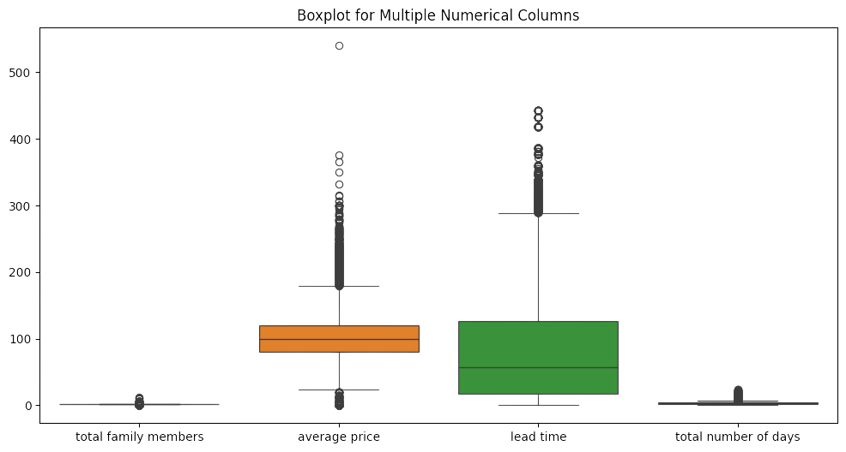

Check for outliers for different numerical features

Slide 10
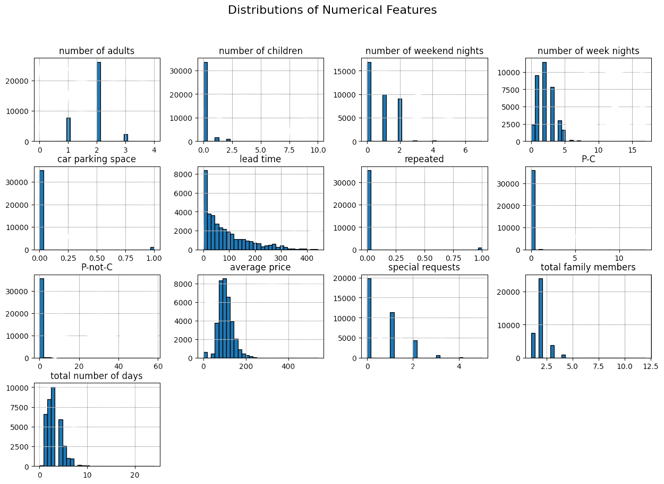
Distributions of Numerical Features

Slide 11
3
Feature Relations

Slide 12
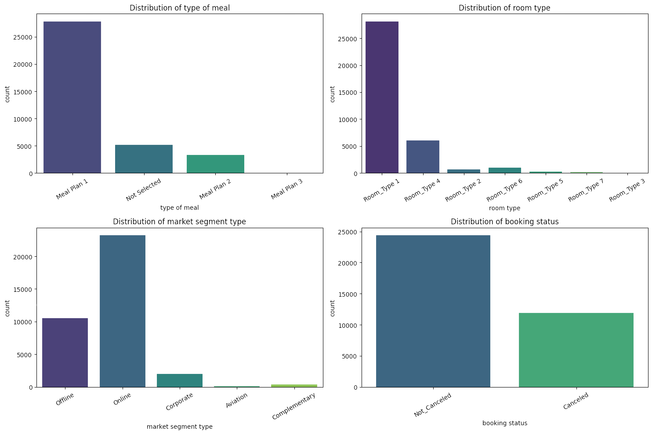
Distributions of Categorical Features

Slide 13
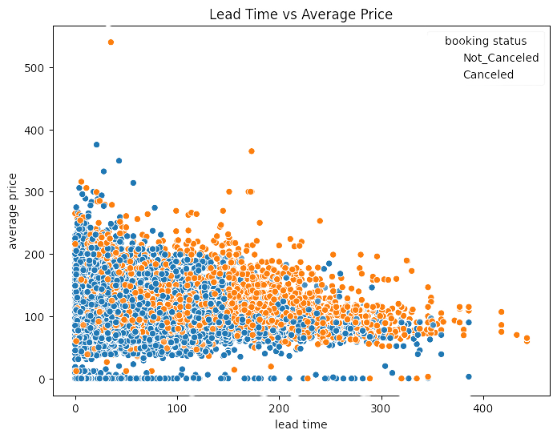
Scatter Plot for lead time Versus average price, taking into consideration Booking status , whether the reservation is cancelled or not

Slide 14
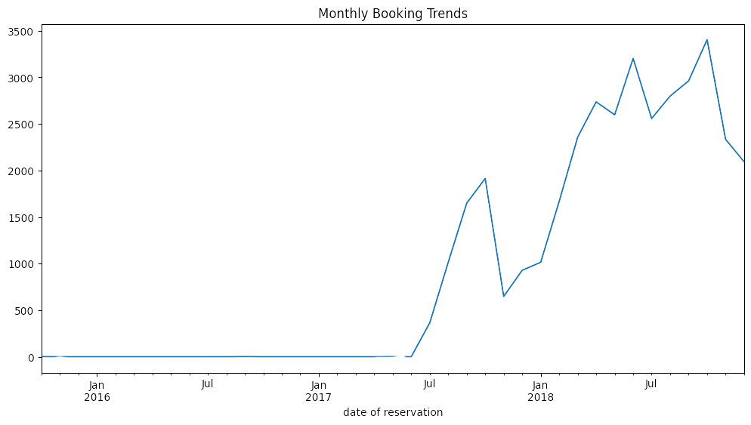
Monthly Booking Trends

Slide 15
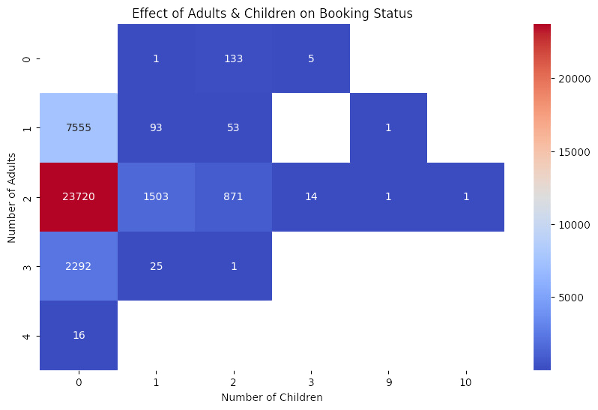
Effect of Adults & Children on Booking Status

Slide 16
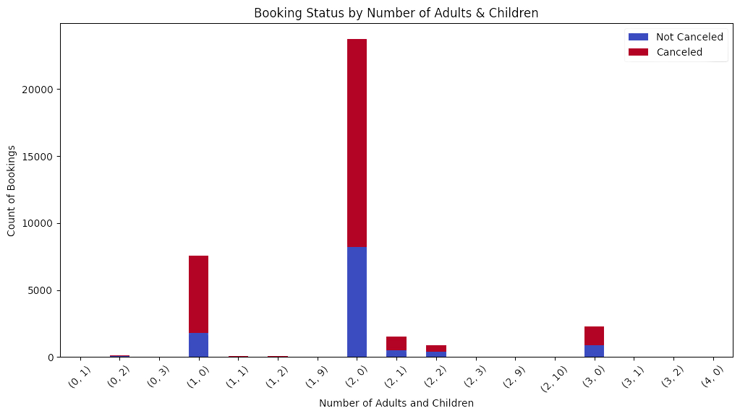
Booking Status for Different Groups

Slide 17
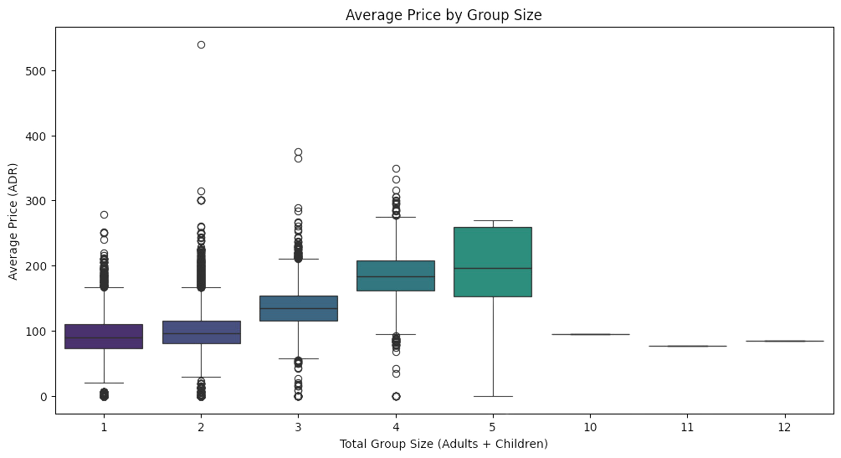
Average Price for Different Groups

Slide 18
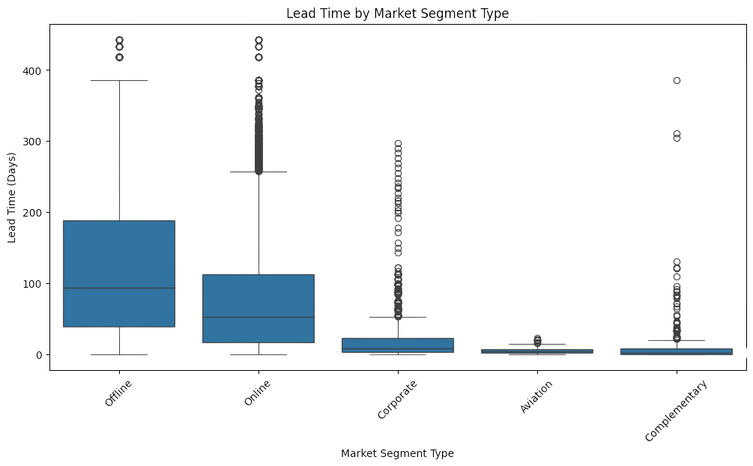
Lead time for different Market Segment Types

Slide 19
Key Inights from EDA
## Key Insights from Data Analysis
### 1. Booking Cancellation Rates
- **67.2%** of bookings were **not canceled**, while **32.8%** were **canceled**.
- This means that **nearly 1 in 3 reservations end in cancellation**, which is a significant portion of total bookings.
### 2. Lead Time and Cancellations
- Canceled bookings have a **much higher average lead time** (~139 days) compared to non-canceled bookings (~59 days).
- This suggests that **the longer a booking is made in advance, the higher the chance of cancellation**.
### 3. Price Impact on Cancellations
- Bookings that were **canceled tend to have a slightly higher average price** compared to those that were not canceled.
- This indicates that **pricing may play a role in customer decisions to cancel reservations**.
### 4. Room Type and Cancellation Trends
- Some **room types have noticeably higher cancellation rates** than others.
- This implies that **certain room categories may be more prone to cancellations**, potentially due to demand fluctuations or customer preferences.

Slide 20
### 5. Market Segment Influence on Cancellations
- Different **market segments show varying cancellation trends**.
- Some segments, like **Online bookings, may have a higher cancellation rate compared to Offline bookings**, suggesting that **customer behavior varies based on the booking channel**.
### 6. Booking Status by Number of Adults & Children
- The most common booking groups are **(2 adults, 0 children)** and **(1 adult, 0 children)**.
- **Cancellation rates are significant**, especially among smaller groups.
- Larger groups (more than 2 adults or multiple children) are much less frequent.
### 7. Price Distribution by Group Size
- **Smaller groups (1-3 people) show extreme price outliers**, indicating possible premium pricing or seasonal fluctuations.
- **Larger groups (5+) have more stable and consistent pricing**, likely due to bulk discounts or family package deals.
### 8. Room Type Preferences by Group Size
- **Room Type 1 is the most booked room**, followed by **Room Type 4**, especially among smaller groups.
- **Larger groups prefer Room Type 5 or 6**, suggesting that **availability of large rooms should be optimized**.
- **Certain room types might have higher cancellation rates**, which could be linked to demand fluctuations.
### 9. Meal Type Preferences by Group Size
- **Meal Type 1 is the most chosen meal** for booking groups, followed by **No Meal Plan selection**, suggesting that other **meal types can be enhanced to increase their selection percentage**.

Slide 21
### 10. Room Type and Meal Plan Distribution
- **Room Type 1 is overwhelmingly the most popular**, with around 28,000 bookings.
- **Meal Type 1 is the most commonly selected meal plan across all room types**.
- **Room Type 4 is the second most popular room type**.
- Many guests, especially in **Room Type 1, opt for no meal plan selection**.
### 11. Lead Time by Market Segment
- **Offline bookings have the highest median lead time and largest variation**.
- **Online bookings have the second-highest lead time spread**.
- **Corporate, Complementary, and Aviation segments tend to have shorter lead times**.
- **Aviation segment shows the most consistent (least variable) lead times**.
### 12. Repeated Guests
- **Most bookings are non-repeated**.
- **Room Type 7 has a is found in combination with all meal types** compared to other room types.
- **Room Type and Meal Type 1 is the most common choice** for reapated bookings.
### 13. Car Parking Requests
- **Very few guests request car parking across all room types**.
- **Room Type 1, despite the highest number of bookings, has a relatively small proportion of parking requests**.
- **The ratio of parking requests to total bookings is consistently low across all room types**.

Slide 22
Thank You

